Slide 1
Electronic Instrumentation Section-1, Ppt-17

Slide 2
Reliability of systems

Slide 3
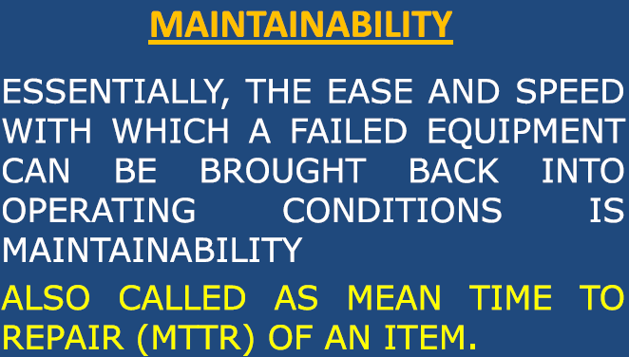

Slide 4
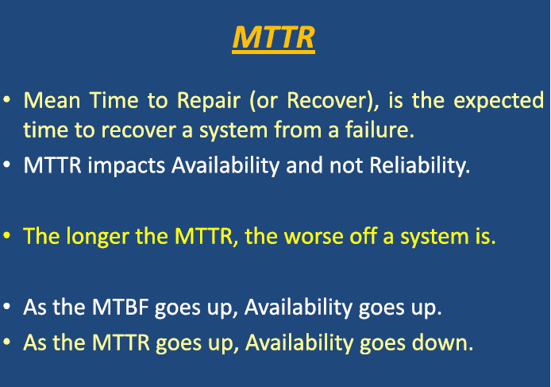

Slide 5
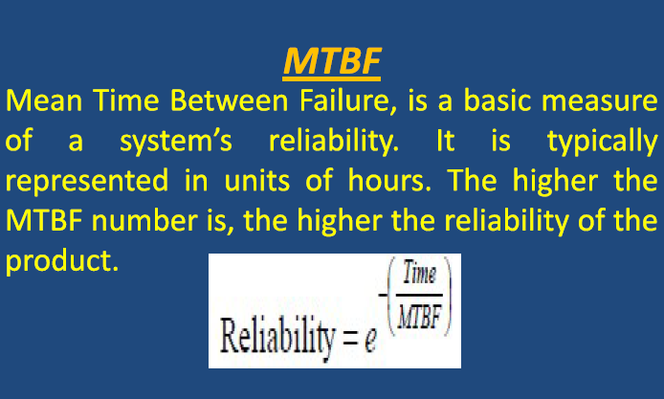

Slide 6


Slide 7
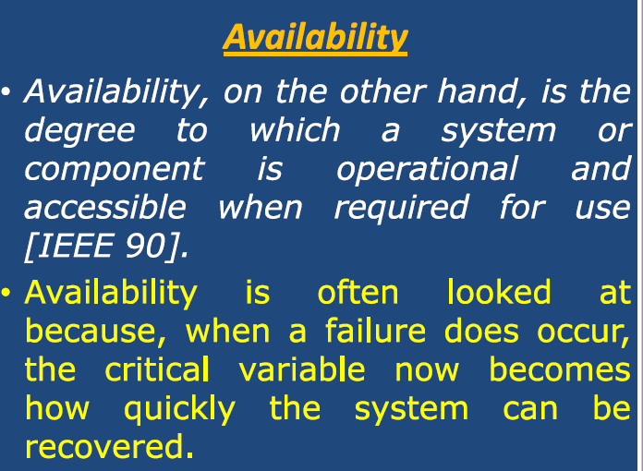

Slide 8
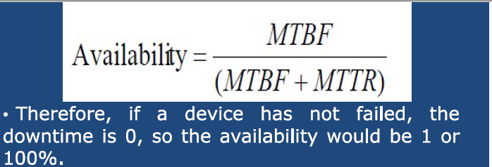

Slide 9


Slide 10


Slide 11

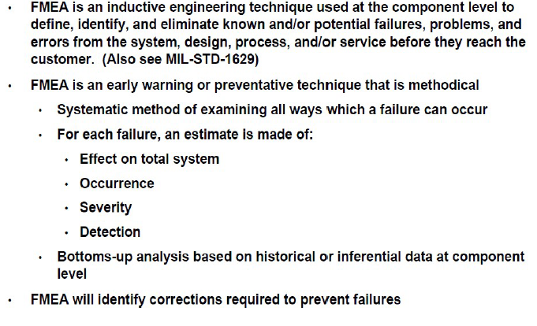

Slide 12
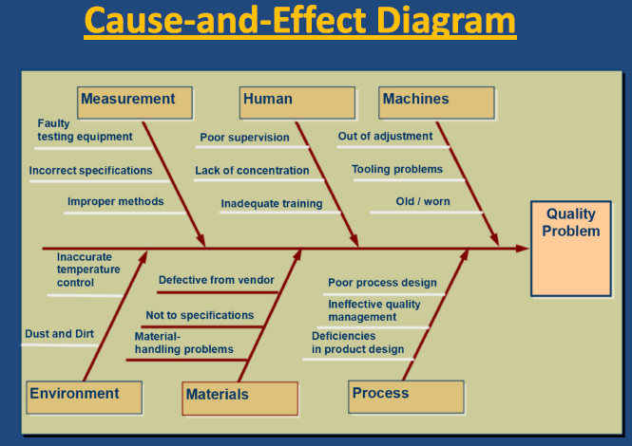

Slide 13
What is redundancy?
Redundancy comes in many forms depending on the application, however for all situations it is about providing reliability and a process alternative to a failing condition.

Slide 14
Type of redundancy
Cold redundancy:
Cold redundancy is best suited to non-critical processes where down time is not a big concern and human intervention is possible.

Slide 15
Warm redundancy:
Warm redundancy design is suited to processes where time and response are important but a momentary outage is still acceptable.

Slide 16
Which of the following is not a phase of “bathtub curve” of hardware reliability? a) Useful Life b) Burn-in c) Wear-out d) Time

Slide 17
How is reliability and failure intensity related to each other? a) direct relation b) inverse relation c) no relation d) none of the mentioned

Slide 18
What is MTTF ? a) Maximum time to failure b) Mean time to failure c) Minimum time to failure d) None of the mentioned

Slide 19
Which among the below mentioned types of redundancy exhibits maximum failure rate? a. Cold standby b. Warm or Tepid c. Hot or Active d. All of the above

Slide 20
What would happen, if an equipment possesses reliability and maintainability to the maximum extent in accordance to MTTR? a. Failure rate is higher & downtime is longer b. Failure rate is lower & downtime is longer c. Failure rate is higher & downtime is shorter d. Failure rate is lower & downtime is shorter

Slide 21
On which factors does the down-time of an equipment at the maintainability phase, depend?
a. Design b. Installation c. Both a and b d. None of the above

Slide 22
Thank you

